Slide 1
Software Engineering
Unit II: Requirements Engineering
Requirement Analysis
Requirements Engineering, Initiating the process, Eliciting Requirements, Building the Requirements Model, Negotiating, Validating requirements, Requirements Analysis, Scenario- Based Analysis, Requirements Modeling strategies, Flow-Oriented Modeling, Class based
modeling, SRS.

Slide 2
Objectives
To introduce the concepts of user and system requirements
To describe functional and non-functional requirements
To explain how software requirements may be organised in a requirements document

Slide 3
Requirements Engineering
Problems with requirements practices
Requirements engineering tasks
Inception
Elicitation
Elaboration
Negotiation
Specification
Validation
Requirements management

Slide 4
The Problems with our Requirements Practices
We have trouble understanding the requirements that we do acquire from the customer
We often record requirements in a disorganized manner
We spend far too little time verifying what we do record
We allow change to control us, rather than establishing mechanisms to control change
Most importantly, we fail to establish a solid foundation for the system or software that the user wants built

Slide 5
The Problems with our Requirements Practices (continued)
Many software developers argue that
Building software is so compelling that we want to jump right in (before having a clear understanding of what is needed)
Things will become clear as we build the software
Project stakeholders will be able to better understand what they need only after examining early iterations of the software
Things change so rapidly that requirements engineering is a waste of time
The bottom line is producing a working program and that all else is secondary
All of these arguments contain some truth, especially for small projects that take less than one month to complete
However, as software grows in size and complexity, these arguments begin to break down and can lead to a failed software project

Slide 6
A Solution: Requirements Engineering
Begins during the communication activity and continues into the modeling activity
Builds a bridge from the system requirements into software design and construction
Allows the requirements engineer to examine
the context of the software work to be performed
the specific needs that design and construction must address
the priorities that guide the order in which work is to be completed
the information, function, and behavior that will have a profound impact on the resultant design

Slide 7
Requirements Engineering Tasks
Seven distinct tasks
Inception
Elicitation
Elaboration
Negotiation
Specification
Validation
Requirements Management
Some of these tasks may occur in parallel and all are adapted to the needs of the project
All strive to define what the customer wants
All serve to establish a solid foundation for the design and construction of the software

Slide 8
Inception
Elicitation
Elaboration
Negotiation
Specification
Validation
Requirements
Management

Slide 9
Inception Task
During inception, the requirements engineer asks a set of questions to establish…
A basic understanding of the problem
The people who want a solution
The nature of the solution that is desired
The effectiveness of preliminary communication and collaboration between the customer and the developer
Through these questions, the requirements engineer needs to…
Identify the stakeholders
Recognize multiple viewpoints
Work toward collaboration
Break the ice and initiate the communication

Slide 10
The First Set of Questions
These questions focus on the customer, other stakeholders, the overall goals, and the benefits
Who is behind the request for this work?
Who will use the solution?
What will be the economic benefit of a successful solution?
Is there another source for the solution that you need?

Slide 11
The Next Set of Questions
These questions enable the requirements engineer to gain a better understanding of the problem and allow the customer to voice his or her perceptions about a solution
How would you characterize "good" output that would be generated by a successful solution?
What problem(s) will this solution address?
Can you show me (or describe) the business environment in which the solution will be used?
Will special performance issues or constraints affect the way the solution is approached?

Slide 12
The Final Set of Questions
These questions focus on the effectiveness of the communication activity itself
Are you the right person to answer these questions? Are your answers "official"?
Are my questions relevant to the problem that you have?
Am I asking too many questions?
Can anyone else provide additional information?
Should I be asking you anything else?

Slide 13
Inception
Elicitation
Elaboration
Negotiation
Specification
Validation
Requirements
Management

Slide 14
Elicitation Task
Eliciting requirements is difficult because of
Problems of scope in identifying the boundaries of the system or specifying too much technical detail rather than overall system objectives
Problems of understanding what is wanted, what the problem domain is, and what the computing environment can handle (Information that is believed to be "obvious" is often omitted)
Problems of volatility because the requirements change over time
Elicitation may be accomplished through two activities
Collaborative requirements gathering
Quality function deployment

Slide 15
Basic Guidelines of Collaborative Requirements Gathering
Meetings are conducted and attended by both software engineers, customers, and other interested stakeholders
Rules for preparation and participation are established
An agenda is suggested that is formal enough to cover all important points but informal enough to encourage the free flow of ideas
A "facilitator" (customer, developer, or outsider) controls the meeting
A "definition mechanism" is used such as work sheets, flip charts, wall stickers, electronic bulletin board, chat room, or some other virtual forum
The goal is to identify the problem, propose elements of the solution, negotiate different approaches, and specify a preliminary set of solution requirements

Slide 16
Quality Function Deployment
This is a technique that translates the needs of the customer into technical requirements for software
It emphasizes an understanding of what is valuable to the customer and then deploys these values throughout the engineering process through functions, information, and tasks
It identifies three types of requirements
Normal requirements: These requirements are the objectives and goals stated for a product or system during meetings with the customer
Expected requirements: These requirements are implicit to the product or system and may be so fundamental that the customer does not explicitly state them
Exciting requirements: These requirements are for features that go beyond the customer's expectations and prove to be very satisfying when present

Slide 17
Elicitation Work Products
The work products will vary depending on the system, but should include one or more of the following items
A statement of need and feasibility
A bounded statement of scope for the system or product
A list of customers, users, and other stakeholders who participated in requirements elicitation
A description of the system's technical environment
A list of requirements (organized by function) and the domain constraints that apply to each
A set of preliminary usage scenarios (in the form of use cases) that provide insight into the use of the system or product under different operating conditions
Any prototypes developed to better define requirements

Slide 18
Inception
Elicitation
Elaboration
Negotiation
Specification
Validation
Requirements
Management

Slide 19
Elaboration Task
During elaboration, the software engineer takes the information obtained during inception and elicitation and begins to expand and refine it
Elaboration focuses on developing a refined technical model of software functions, features, and constraints
It is an analysis modeling task
Use cases are developed
Domain classes are identified along with their attributes and relationships
State machine diagrams are used to capture the life on an object
The end result is an analysis model that defines the functional, informational, and behavioral domains of the problem

Slide 20
Developing Use Cases
Step One – Define the set of actors that will be involved in the story
Actors are people, devices, or other systems that use the system or product within the context of the function and behavior that is to be described
Actors are anything that communicate with the system or product and that are external to the system itself
Step Two – Develop use cases, where each one answers a set of questions

Slide 21
Questions Commonly Answered by a Use Case
Who is the primary actor(s), the secondary actor(s)?
What are the actor’s goals?
What preconditions should exist before the scenario begins?
What main tasks or functions are performed by the actor?
What exceptions might be considered as the scenario is described?
What variations in the actor’s interaction are possible?
What system information will the actor acquire, produce, or change?
Will the actor have to inform the system about changes in the external environment?
What information does the actor desire from the system?
Does the actor wish to be informed about unexpected changes?

Slide 22
Elements of the Analysis Model
Scenario-based elements
Describe the system from the user's point of view using scenarios that are depicted in use cases and activity diagrams
Class-based elements
Identify the domain classes for the objects manipulated by the actors, the attributes of these classes, and how they interact with one another; they utilize class diagrams to do this
Behavioral elements
Use state diagrams to represent the state of the system, the events that cause the system to change state, and the actions that are taken as a result of a particular event; can also be applied to each class in the system
Flow-oriented elements
Use data flow diagrams to show the input data that comes into a system, what functions are applied to that data to do transformations, and what resulting output data are produced

Slide 23
Inception
Elicitation
Elaboration
Negotiation
Specification
Validation
Requirements
Management

Slide 24
Negotiation Task
During negotiation, the software engineer reconciles the conflicts between what the customer wants and what can be achieved given limited business resources
Requirements are ranked (i.e., prioritized) by the customers, users, and other stakeholders
Risks associated with each requirement are identified and analyzed
Rough guesses of development effort are made and used to assess the impact of each requirement on project cost and delivery time
Using an iterative approach, requirements are eliminated, combined and/or modified so that each party achieves some measure of satisfaction

Slide 25
The Art of Negotiation
Recognize that it is not competition
Map out a strategy
Listen actively
Focus on the other party’s interests
Don’t let it get personal
Be creative
Be ready to commit

Slide 26
Inception
Elicitation
Elaboration
Negotiation
Specification
Validation
Requirements
Management

Slide 27
Specification Task
A specification is the final work product produced by the requirements engineer
It is normally in the form of a software requirements specification
It serves as the foundation for subsequent software engineering activities
It describes the function and performance of a computer-based system and the constraints that will govern its development
It formalizes the informational, functional, and behavioral requirements of the proposed software in both a graphical and textual format

Slide 28
Typical Contents of a Software Requirements Specification
Requirements
Required states and modes
Software requirements grouped by capabilities (i.e., functions, objects)
Software external interface requirements
Software internal interface requirements
Software internal data requirements
Other software requirements (safety, security, privacy, environment, hardware, software, communications, quality, personnel, training, logistics, etc.)
Design and implementation constraints
Qualification provisions to ensure each requirement has been met
Demonstration, test, analysis, inspection, etc.
Requirements traceability
Trace back to the system or subsystem where each requirement applies

Slide 29
Inception
Elicitation
Elaboration
Negotiation
Specification
Validation
Requirements
Management

Slide 30
Validation Task
During validation, the work products produced as a result of requirements engineering are assessed for quality
The specification is examined to ensure that
all software requirements have been stated unambiguously
inconsistencies, omissions, and errors have been detected and corrected
the work products conform to the standards established for the process, the project, and the product
The formal technical review serves as the primary requirements validation mechanism
Members include software engineers, customers, users, and other stakeholders

Slide 31
Questions to ask when Validating Requirements
Is each requirement consistent with the overall objective for the system/product?
Have all requirements been specified at the proper level of abstraction? That is, do some requirements provide a level of technical detail that is inappropriate at this stage?
Is the requirement really necessary or does it represent an add-on feature that may not be essential to the objective of the system?
Is each requirement bounded and unambiguous?
Does each requirement have attribution? That is, is a source (generally, a specific individual) noted for each requirement?

Slide 32
Questions to ask when Validating Requirements (continued)
Do any requirements conflict with other requirements?
Is each requirement achievable in the technical environment that will house the system or product?
Is each requirement testable, once implemented?
Approaches: Demonstration, actual test, analysis, or inspection
Does the requirements model properly reflect the information, function, and behavior of the system to be built?
Has the requirements model been “partitioned” in a way that exposes progressively more detailed information about the system?

Slide 33
Inception
Elicitation
Elaboration
Negotiation
Specification
Validation
Requirements
Management

Slide 34
Requirements Management Task
During requirements management, the project team performs a set of activities to identify, control, and track requirements and changes to the requirements at any time as the project proceeds
Each requirement is assigned a unique identifier
The requirements are then placed into one or more traceability tables
These tables may be stored in a database that relate features, sources, dependencies, subsystems, and interfaces to the requirements
A requirements traceability table is also placed at the end of the software requirements specification

Slide 35
Summary
Inception
Elicitation
Elaboration
Negotiation
Specification
Validation
Requirements
Management
☺

Slide 36
Analysis Modeling
Requirements analysis
Flow-oriented modeling
Scenario-based modeling
Class-based modeling
Behavioral modeling
(Source: Pressman, R. Software Engineering: A Practitioner’s Approach. McGraw-Hill, 2005)

Slide 37
Goals of Analysis Modeling
Provides the first technical representation of a system
Is easy to understand and maintain
Deals with the problem of size by partitioning the system
Uses graphics whenever possible
Differentiates between essential information versus implementation information
Helps in the tracking and evaluation of interfaces
Provides tools other than narrative text to describe software logic and policy

Slide 38
A Set of Models
Flow-oriented modeling – provides an indication of how data objects are transformed by a set of processing functions
Scenario-based modeling – represents the system from the user's point of view
Class-based modeling – defines objects, attributes, and relationships
Behavioral modeling – depicts the states of the classes and the impact of events on these states

Slide 39
Requirements Analysis

Slide 40
Purpose
Specifies the software's operational characteristics
Indicates the software's interfaces with other system elements
Establishes constraints that the software must meet
Provides the software designer with a representation of information, function, and behavior
This is later translated into architectural, interface, class/data and component-level designs
Provides the developer and customer with the means to assess quality once the software is built

Slide 41
Overall Objectives
Three primary objectives
To describe what the customer requires
To establish a basis for the creation of a software design
To define a set of requirements that can be validated once the software is built
All elements of an analysis model are directly traceable to parts of the design model, and some parts overlap

Slide 42
Analysis Rules of Thumb
The analysis model should focus on requirements that are visible within the problem or business domain
The level of abstraction should be relatively high
Each element of the analysis model should add to an overall understanding of software requirements and provide insight into the following
Information domain, function, and behavior of the system
The model should delay the consideration of infrastructure and other non-functional models until the design phase
First complete the analysis of the problem domain
The model should minimize coupling throughout the system
Reduce the level of interconnectedness among functions and classes
The model should provide value to all stakeholders
The model should be kept as simple as can be

Slide 43
Domain Analysis
Definition
The identification, analysis, and specification of common, reusable capabilities within a specific application domain
Do this in terms of common objects, classes, subassemblies, and frameworks
Sources of domain knowledge
Technical literature
Existing applications
Customer surveys and expert advice
Current/future requirements
Outcome of domain analysis
Class taxonomies
Reuse standards
Functional and behavioral models
Domain languages

Slide 44
Analysis Modeling Approaches
Structured analysis
Considers data and the processes that transform the data as separate entities
Data is modeled in terms of only attributes and relationships (but no operations)
Processes are modeled to show the 1) input data, 2) the transformation that occurs on that data, and 3) the resulting output data
Object-oriented analysis
Focuses on the definition of classes and the manner in which they collaborate with one another to fulfill customer requirements

Slide 45
Elements of the Analysis Model
Object-oriented Analysis
Structured Analysis
Scenario-based
modeling
Flow-oriented
modeling
Use case text
Use case diagrams
Activity diagrams
Swim lane diagrams
Data structure diagrams
Data flow diagrams
Control-flow diagrams
Processing narratives
Class-based
modeling
Behavioral
modeling
Class diagrams
Analysis packages
CRC models
Collaboration diagrams
State diagrams
Sequence diagrams

Slide 46
Flow-oriented Modeling

Slide 47
Data Modeling
Identify the following items
Data objects (Entities)
Data attributes
Relationships
Cardinality (number of occurrences)

Slide 48
Data Flow and Control Flow
Data Flow Diagram
Depicts how input is transformed into output as data objects move through a system
Process Specification
Describes data flow processing at the lowest level of refinement in the data flow diagrams
Control Flow Diagram
Illustrates how events affect the behavior of a system through the use of state diagrams

Slide 49
Diagram Layering and Process Refinement
Context-level diagram
Level 1 diagram
Process Specification

Slide 50
Scenario-based Modeling

Slide 51
Writing Use Cases
It is effective to use the first person “I” to describe how the actor interacts with the software
Format of the text part of a use case
Use-case title:
Actor:
Description: I …

Slide 52
Example Use Case Diagram
Make automated menu
selections
Expert Menu
System
Order food and drink
Notify customer that
food and drink are ready
Cook
Customer
Pay for food and drink
Payment
System

Slide 53
Activity Diagrams
Supplements the use case by providing a graphical representation of the flow of interaction within a specific scenario
Uses flowchart-like symbols
Rounded rectangle - represent a specific system function/action
Arrow - represents the flow of control from one function/action to another
Diamond - represents a branching decision
Solid bar – represents the fork and join of parallel activities

Slide 54
Example Activity Diagram
Set counter = positive n
Set accumulator = initial value
n > 1
F
T
Set accumulator = accumulator * n
Set n = n - 1
F
(n mod 5) == 0
T
Display accumulator value
Return accumulator value

Slide 55
Class-based Modeling

Slide 56
Identifying Analysis Classes
Perform a grammatical parse of the problem statement or use cases
Classes are determined by underlining each noun or noun clause
A class required to implement a solution is part of the solution space
A class necessary only to describe a solution is part of the problem space
A class should NOT have an imperative procedural name (i.e., a verb)
List the potential class names in a table and "classify" each class according to some taxonomy and class selection characteristics
A potential class should satisfy nearly all (or all) of the selection characteristics to be considered a legitimate problem domain class
Potential classes | General classification | Selection Characteristics

Slide 57
Identifying Analysis Classes (continued)
General classifications for a potential class
External entity (e.g., another system, a device, a person)
Thing (e.g., report, screen display)
Occurrence or event (e.g., movement, completion)
Role (e.g., manager, engineer, salesperson)
Organizational unit (e.g., division, group, team)
Place (e.g., manufacturing floor, loading dock)
Structure (e.g., sensor, vehicle, computer)

Slide 58
Identifying Analysis Classes (continued)
Six class selection characteristics
Retained information
Information must be remembered about the system over time
Needed services
Set of operations that can change the attributes of a class
Multiple attributes
Whereas, a single attribute may denote an atomic variable rather than a class
Common attributes
A set of attributes apply to all instances of a class
Common operations
A set of operations apply to all instances of a class
Essential requirements
Entities that produce or consume information

Slide 59
Defining Attributes of a Class
Attributes of a class are those nouns from the grammatical parse that reasonably belong to a class
Attributes hold the values that describe the current properties or state of a class
An attribute may also appear initially as a potential class that is later rejected because of the class selection criteria
In identifying attributes, the following question should be answered
What data items (composite and/or elementary) will fully define a specific class in the context of the problem at hand?
Usually an item is not an attribute if more than one of them is to be associated with a class

Slide 60
Defining Operations of a Class
Operations define the behavior of an object
Four categories of operations
Operations that manipulate data in some way to change the state of an object (e.g., add, delete, modify)
Operations that perform a computation
Operations that inquire about the state of an object
Operations that monitor an object for the occurrence of a controlling event

Slide 61
An operation has knowledge about the state of a class and the nature of its associations
The action performed by an operation is based on the current values of the attributes of a class
Using a grammatical parse again, circle the verbs; then select the verbs that relate to the problem domain classes that were previously identified

Slide 62
Example Class Box
Class Name
Component
+ componentID
- telephoneNumber
- componentStatus
- delayTime
- masterPassword
- numberOfTries
Attributes
+ program()
+ display()
+ reset()
+ query()
- modify()
+ call()
Operations

Slide 63
Association, Generalization and Dependency
Association
Represented by a solid line between two classes directed from the source class to the target class
Used for representing (i.e., pointing to) object types for attributes
May also be a part-of relationship (i.e., aggregation), which is represented by a diamond-arrow
Generalization
Portrays inheritance between a super class and a subclass
Is represented by a line with a triangle at the target end
Dependency
A dependency exists between two elements if changes to the definition of one element (i.e., the source or supplier) may cause changes to the other element (i.e., the client)
Examples
One class calls a method of another class
One class utilizes another class as a parameter of a method

Slide 64
Example Class Diagram
Accountant
Auditor
Record
Keeper
Input Verifier
Production
Manager
Transaction
Processor
Error Log
Input Handler
Report
Generator
Account List
Account
1..n
Local File
Handler
Remote File
Handler
Accounts
Receivable
Accounts
Payable

Slide 65
Behavioral Modeling

Slide 66
Creating a Behavioral Model
Identify events found within the use cases and implied by the attributes in the class diagrams
Build a state diagram for each class, and if useful, for the whole software system

Slide 67
Identifying Events in Use Cases
An event occurs whenever an actor and the system exchange information
An event is NOT the information that is exchanged, but rather the fact that information has been exchanged
Some events have an explicit impact on the flow of control, while others do not
An example is the reading of a data item from the user versus comparing the data item to some possible value

Slide 68
Building a State Diagram
A state is represented by a rounded rectangle
A transition (i.e., event) is represented by a labeled arrow leading from one state to another
Syntax: trigger-signature [guard]/activity
The active state of an object indicates the current overall status of the object as is goes through transformation or processing
A state name represents one of the possible active states of an object
The passive state of an object is the current value of all of an object's attributes
A guard in a transition may contain the checking of the passive state of an object

Slide 69
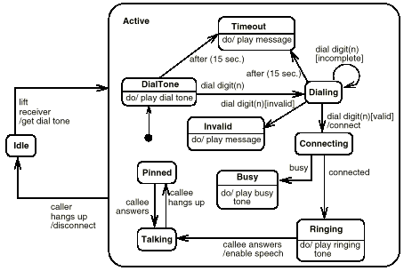
Example- state diagram

Slide 70
Example State Diagram
pop / set n to 0; return error
push [n – 2 < max]
push [n = 0]
Empty
Stack
Partially
Filled Stack
pop [n > 1]
pop [n = 1]
pop [n = max]
push [n - 1 = max]
Full Stack
push / set n to max; return error

Slide 71
Example- state diagram

Slide 72
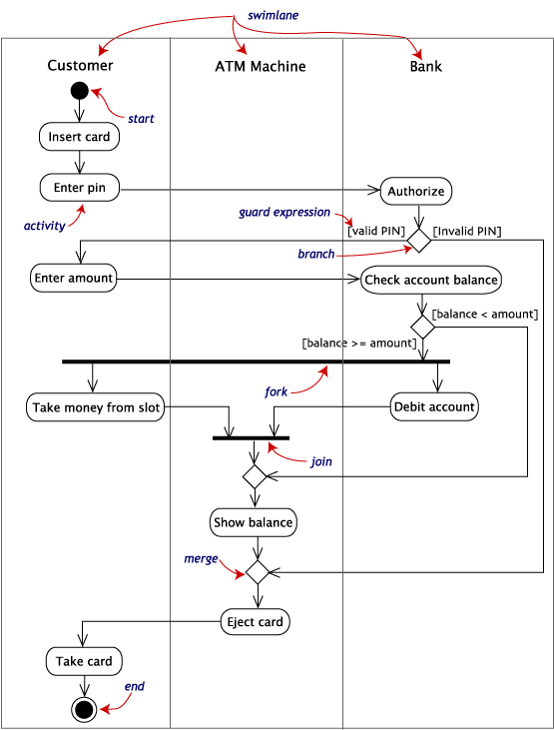
Activity diagram example

Slide 73
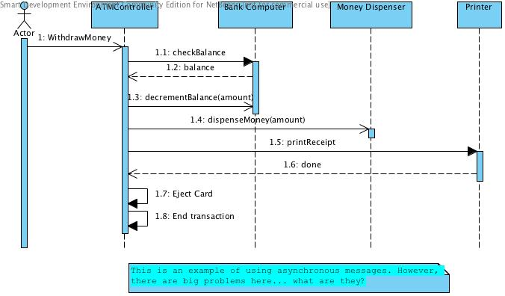
Sequence diagram

Slide 74
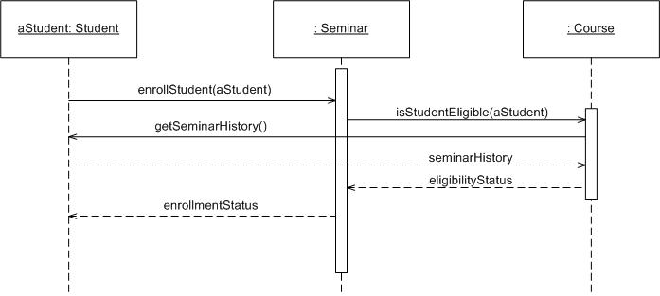
Example-sequence diagram

Slide 75
Summary: Elements of the Analysis Model
Object-oriented Analysis
Structured Analysis
Scenario-based
modeling
Flow-oriented
modeling
Use case text
Use case diagrams
Activity diagrams
Swim lane diagrams
Data flow diagrams
Control-flow diagrams
Processing narratives
Class-based
modeling
Behavioral
modeling
Class diagrams
Analysis packages
CRC models
Collaboration diagrams
State diagrams
Sequence diagrams
☺

